Slide 1
Clash between two super powers: The Cold War
Unit 2-Class 1
Relate the "Cold War" confrontation of the "Super Powers" worldwide, the development of nuclear energy, its impact on the Third World, especially in Latin America.

Slide 2
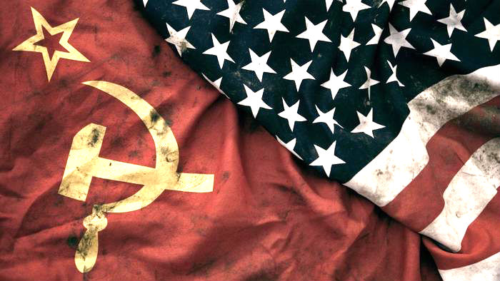
The horror of World War II, involving 61 countries with a human cost of 55,000,000 lives, made the world establish agreements such as the United Nations letter that begins: PREAMBLE We the people of the United Nations resolved to preserve the coming generations from the scourge of war that twice during our life has inflicted on humanity undecidable suffering. We commit: * To unite our forces for the maintenance of international peace and security * To ensure, through the acceptance of principles and the adoption of methods, that it will not be used; Armed force but in service of common interest

Slide 3
KEY TERMS
CAPITALISM: an economic system based on the private ownership of the means of production, distribution, and exchange, characterized by the freedom of capitalists to operate or manage their property for profit in competitive conditions
COMMUNISM: a theory or system of social organization based on the holding of all property in common, actual ownership being ascribed to the community as a whole or to the state.
NATO: North Atlantic Treaty Organization
WARSAW PACT: A military alliance of communist nations in eastern Europe.

Slide 4
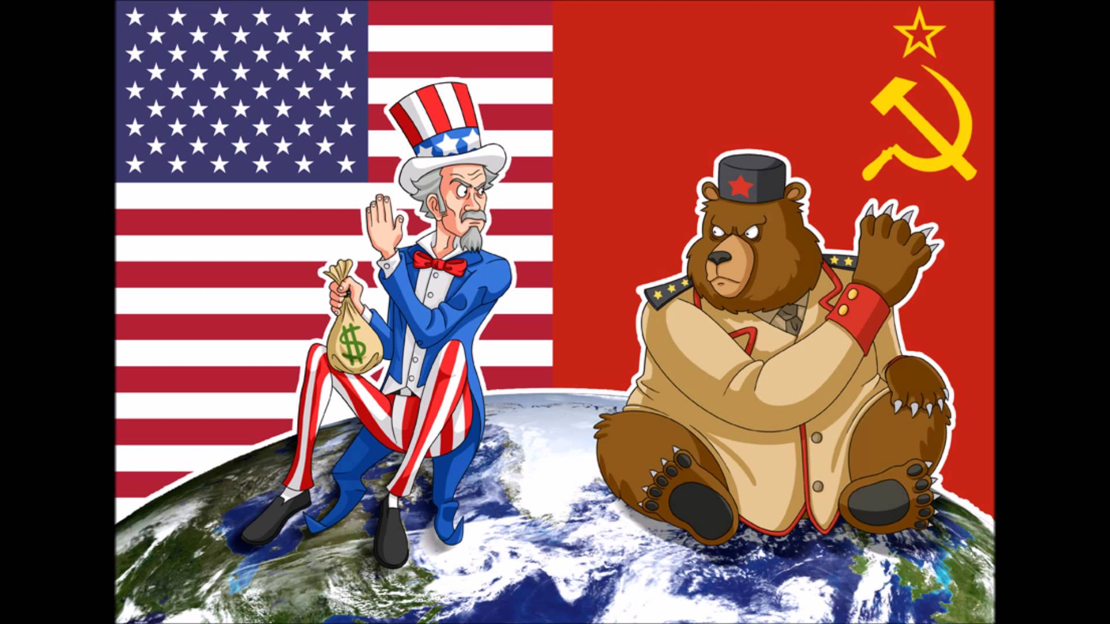
LET´S ANALYZE
If in 1945 these aims were made, why for more than 40 years humanity lived on the brink of a third world war?
What was the iron curtain?
ANSWER THIS QUESTION BY CLICKING ON THE LINK BELOW
WHAT DO YOU THINK THIS PICTURE REPRESENTS?
https://www.britannica.com/event/Iron-Curtain

Slide 5
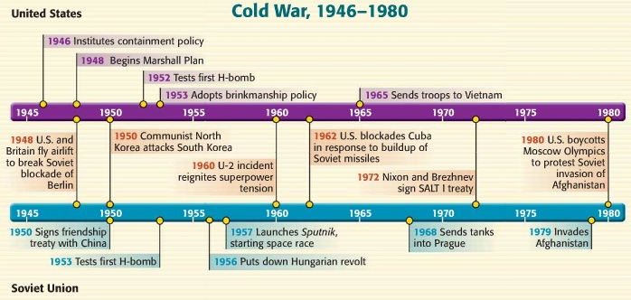
TIMELINE
This timeline must be printed and glued in notebooks

Slide 6
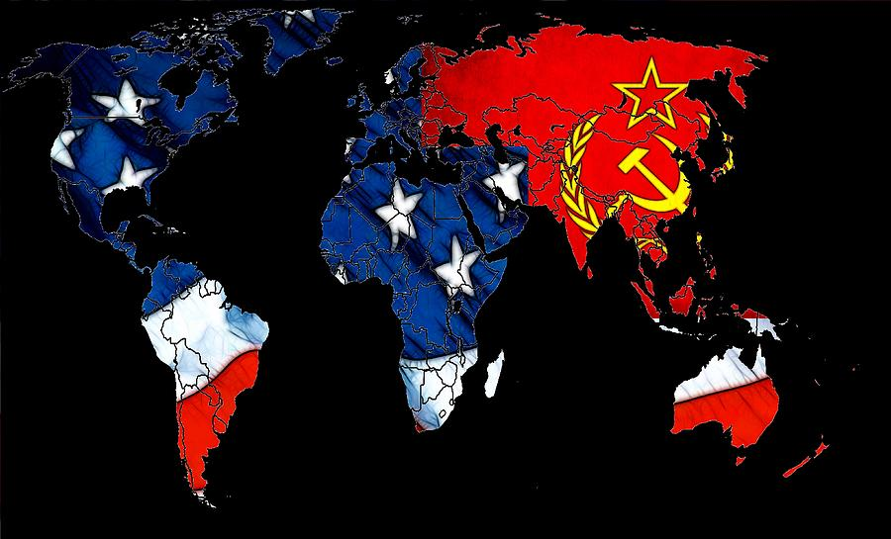

Why the name Cold War?
Although it was a period of great stress between the great powers, a direct combat never happened.
They fought with other resources: psychological warfare campaigns, espionage, investments in third countries, military blockades, economic sanctions, initiatives in international organizations. Generations lived in tension for forty years, with the feeling that World War III would break out at any time.

Slide 7
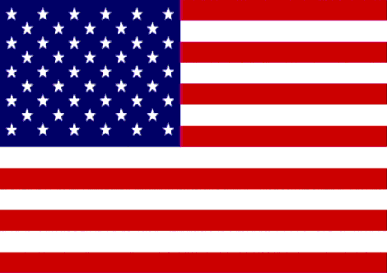
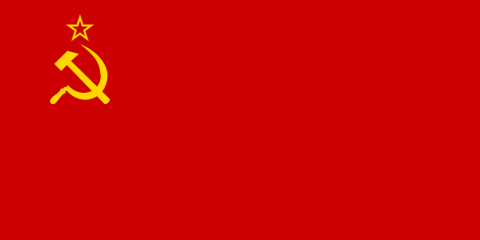
Confrontation between two superpowers
United States
The era of confrontation and competition between the U.S. and the Soviet Union began when the threat of nuclear war created constant world tension
Soviet Union
Capitalism
Communism

Slide 8
Different Philosophies
United States
Soviet Union
Believed in a communism government
Believed in workers revolting (striking) against business owners and taking control of government
Wanted to control countries between Russia and Germany
Believed in democratic government
Believed economic stability would keep peace in the word
Believed the free enterprise system was necessary for economic growth

Slide 9
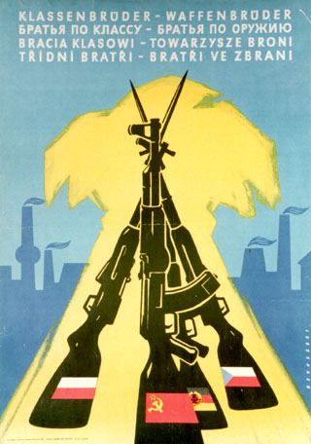
Military agreements between
opposing blocs
The NATO flag
Warsaw poster
Warsaw Treaty of Friendship, Cooperation, was formed on May 14, 1955 in Warsaw, Poland. There were eight members of this pact. This pact is, since 1991, extinct or “nonexistent”.
Albania, Bulgaria, Czechoslovakia, Hungary, Poland, German Democratic Republic, Romania, Soviet Union and China
The North Atlantic Treaty Organization include fourteen nations in an alliance. NATO was officially formed on April 4, 1949. NATO has become a political force rather than a military force.
US, Canada, UK, France, Italy, Norway, Denmark, Iceland, Belgium, Netherlands, Luxembourg, Portugal, Greece, Turkey, Federal Republic of Germany and Spain

Slide 10
1st Phase- Maximun Tension (1950-1953)

Slide 11
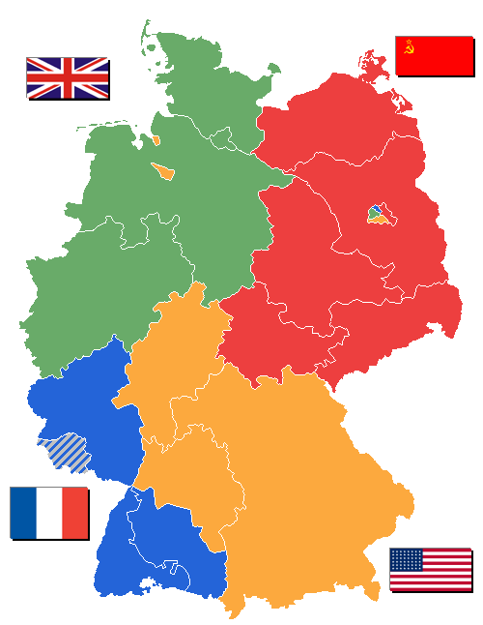
Germany Divided
Occupation zones after 1945. Berlin is the multinational area within the Soviet zone.

Slide 12
Berlin Blockade
(1948–49) was the first major crisis of the Cold War
The Soviet Union wanted all of Berlin. On June 24, 1948 the Soviet Union blocked off all roads and rail roads entering and leaving East Germany. The people in Berlin were starving so the United States and Britain sent airlifts of food. They lasted 321 days. A plane took off every three minutes to bring the food and medicine. The blockade ended May 11, 1949
East Berlin
Democratic Republic of Germany (DRG)
West Berlin
Federal Republic of Germany (FRG)
https://www.youtube.com/watch?v=lT8JNFcd2l8

Slide 13
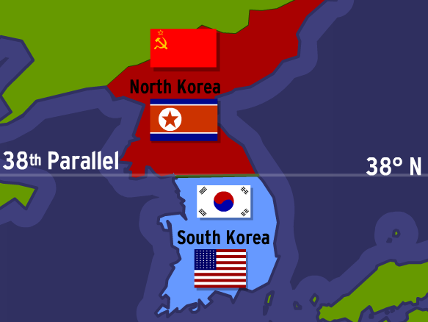
The Korean War (1950-1953)
Korea was invaded by Japan since 1910. It was divided in two parts North Korea (Soviet influence) and South korea (US influence)
North Korea with the support of Stalin invaded the South in 1950. Gnral. Mac Arthur, represented US troops, threatened to use the atomic bomb; this warning caused his destitution. After Stalin´s death in 1953; a treaty was signed where it was stated that the division would continue. This division still exists.

Slide 14
2nd Phase- Peaceful Coexistence (1953-1977)
In this phase, negotiation became an option although there were some conflicts of great intensity

Slide 15
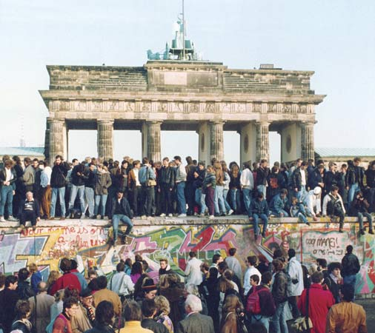
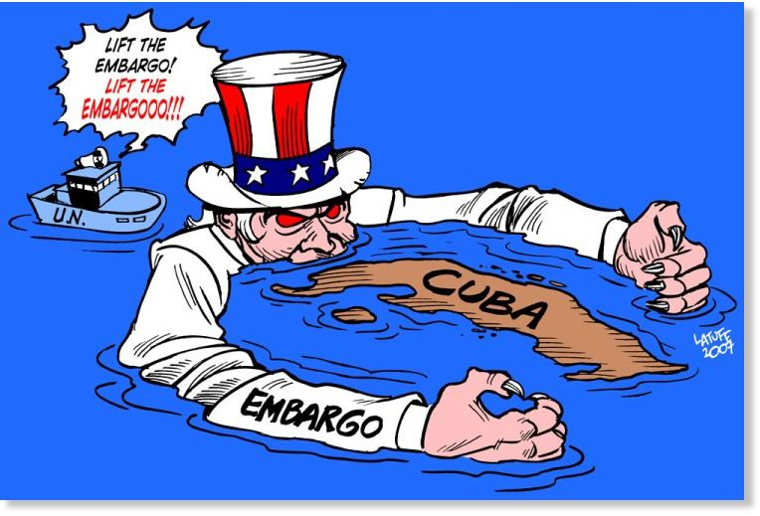
Major conflicts of the time
The Berlin Wall: The GDR decided to stop the emigration of its population to the west, building a wall "Berlin Wall" which lasted 30 years. This became a symbol of the Cold War. Germans from East and West came together to break down the wall in November 1989. You can find pieces of wall in different parts of the world. “NO MANS LAND”
Cuban blockade: The Soviet Union installed a base of short-range missiles in Cuba. US blocked the island 1962 preventing the arrival of Soviet military equipment. Soviet leader Khrushchev bases dismantled but the lock still exists. This embargo is the most prolonged and has been condemned 21 times by the UN

Slide 16
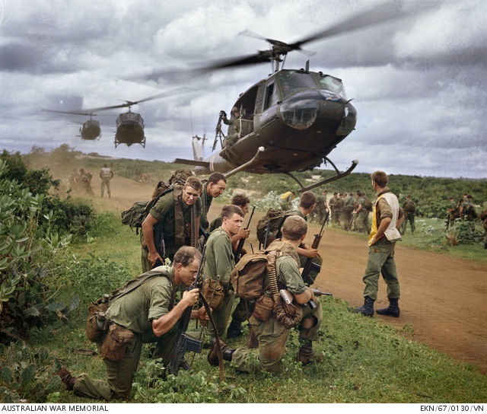
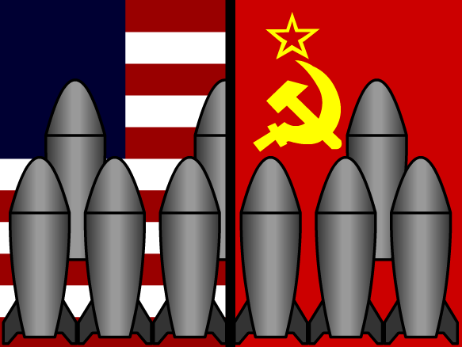
Major conflicts of the time
The Vietman War: US intervention since 1962. It was an effort to avoid new communist regimes in Asia. Although human and economic sacrifices, USA suffered the greatest military defeat in its history.
Arms race: in 1977 the Soviet Union deployed missiles in areas of European and Asian influence, increase the support of guerrillas to keep the pro-Soviet government. USA installed missiles on European bases and deployed a space shield called "Star Wars" Faced with danger some countries signed the 1968 nuclear Non-Proliferation Treaty.

Slide 17
3rd Phase- Regrowth and end (1977-1989)

Slide 18
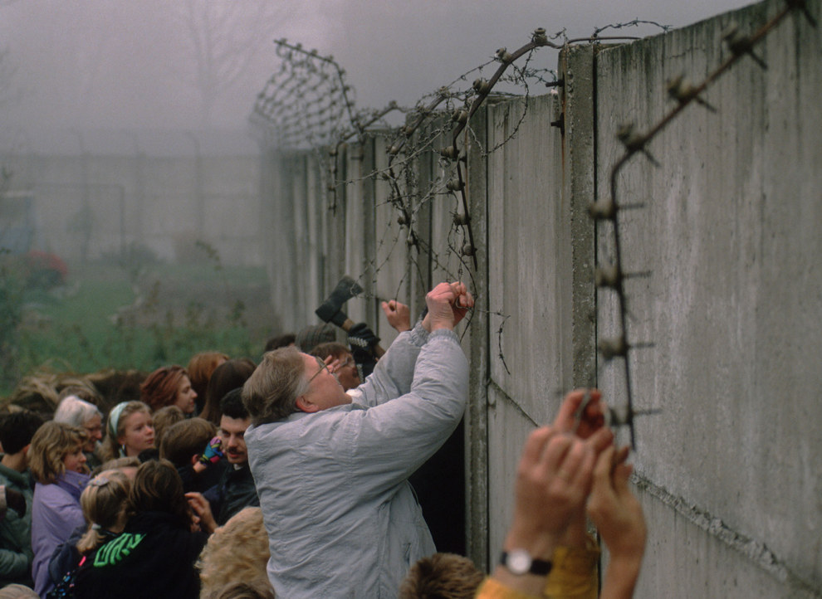
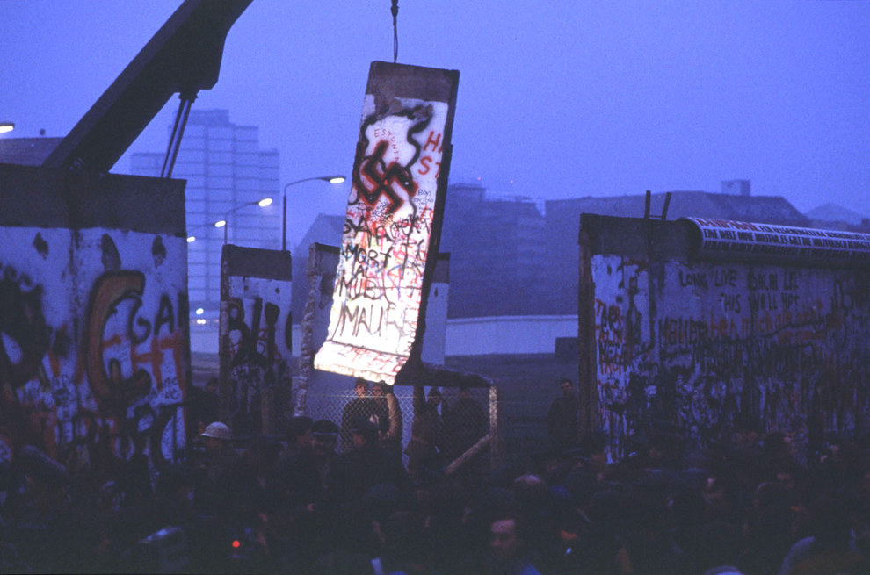
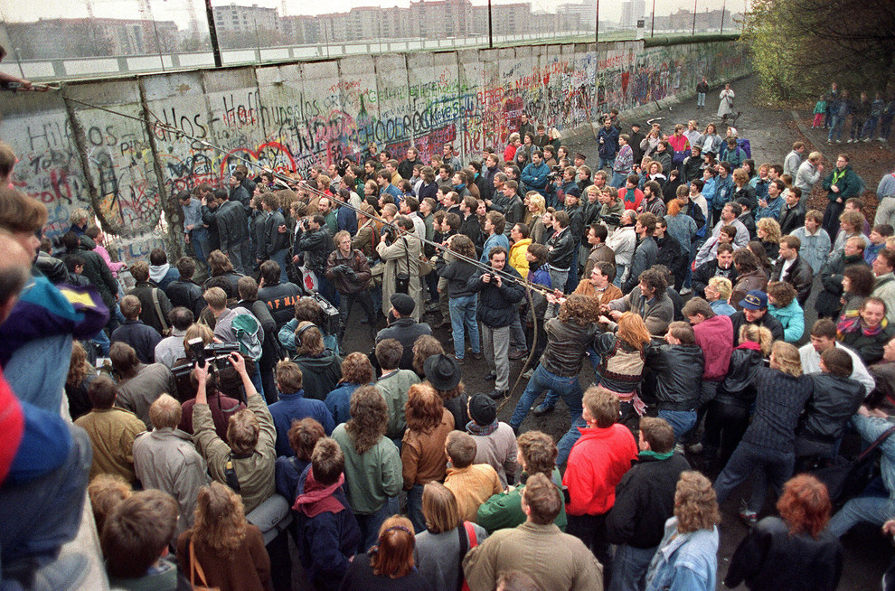
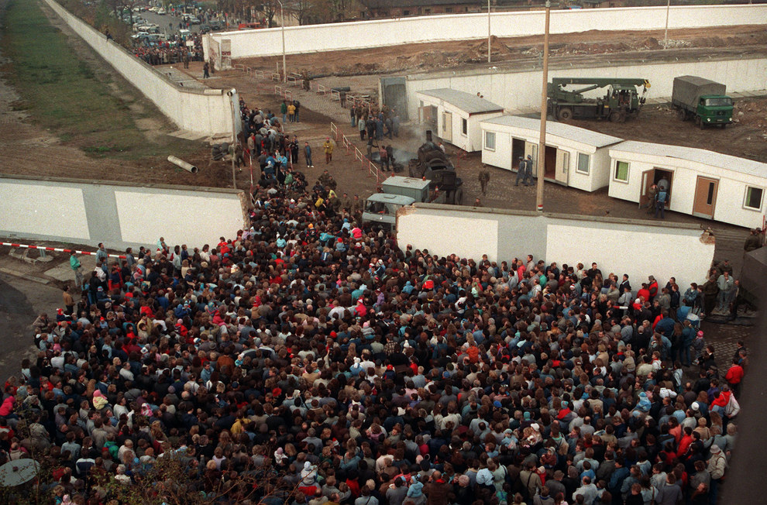
The Fall of the Berlin Wall meant the end of the conflict
https://www.youtube.com/watch?v=zmRPP2WXX0U

Slide 19
Effects of Cold War in the Third World: Non-Aligned Countries

Slide 20
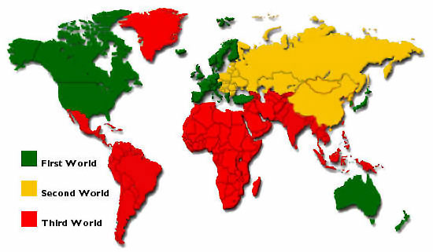
Third World Countries
An effect of decolonization and the politics of a cold war arose the so-called non-aligned countries (countries that were neither one side nor the other) Latin America experienced a climate of tense calm(Manifestations of tension and nuclear development), as a consequence there were many dictatorships sponsored by the United States for the spread of communism

Slide 21
NUCLEAR DEVELOPMENT At the end of World War II nuclear weapons were used Nuclear weapons caused other nations to invest in weapons research In 1968 some countries signed the treaty of Nuclear Nonproliferation Current science, especially medicine would not be the same without the contributions of this branch of physics
TENSION MANIFESTATIONS
The extreme tension was always solved by conflicts in places far from the super powers
Strategies of ideological confrontation and economic competence
Nuclear and military threats existed

Slide 22
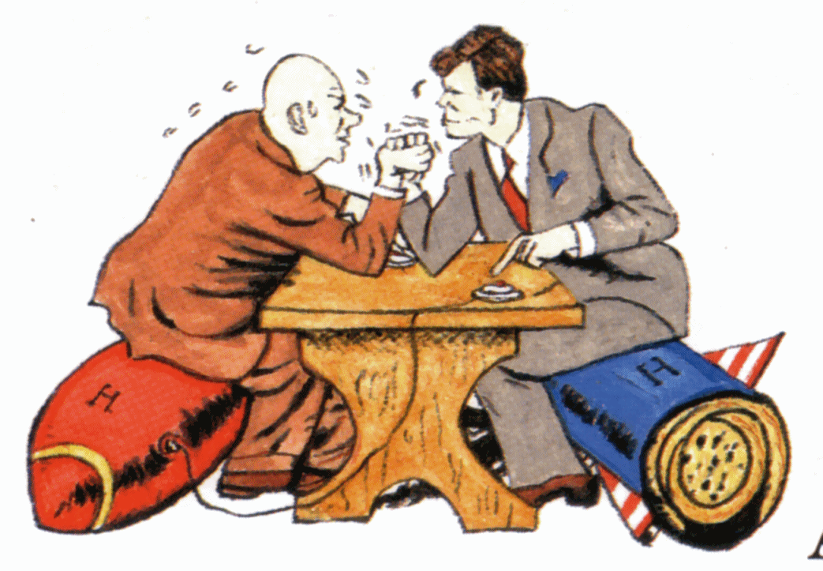
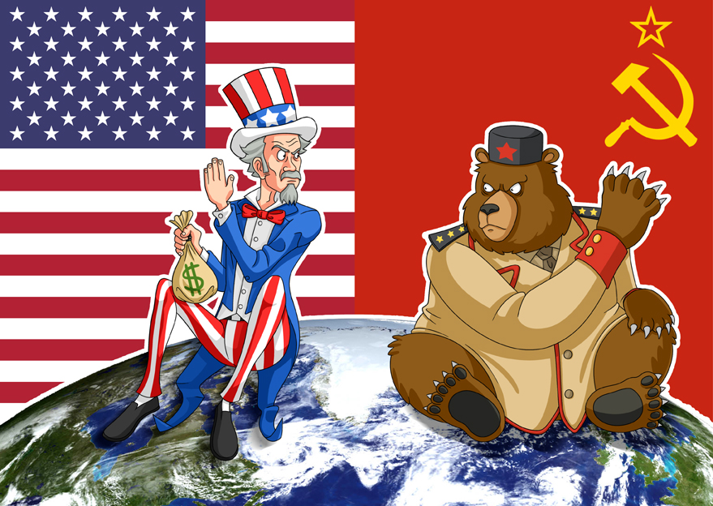
Cartoon analysis Choose one cartoon and make its analysis

Slide 23
Check the following links
https://www.youtube.com/watch?v=tLJKVVtiR3g
Why Did the Cold War Begin?
http://www.history.com/topics/cold-war/formation-of-nato-and-warsaw-pact
FORMATION OF NATO AND WARSAW PACT
https://www.youtube.com/watch?v=W7YE-N448fg
Why Was A Wall Built Around West Berlin?

